Slide 1
Connecting ESSA to School Libraries
Saturday, September 17, 2016
Massachusetts School Library Association

Slide 2
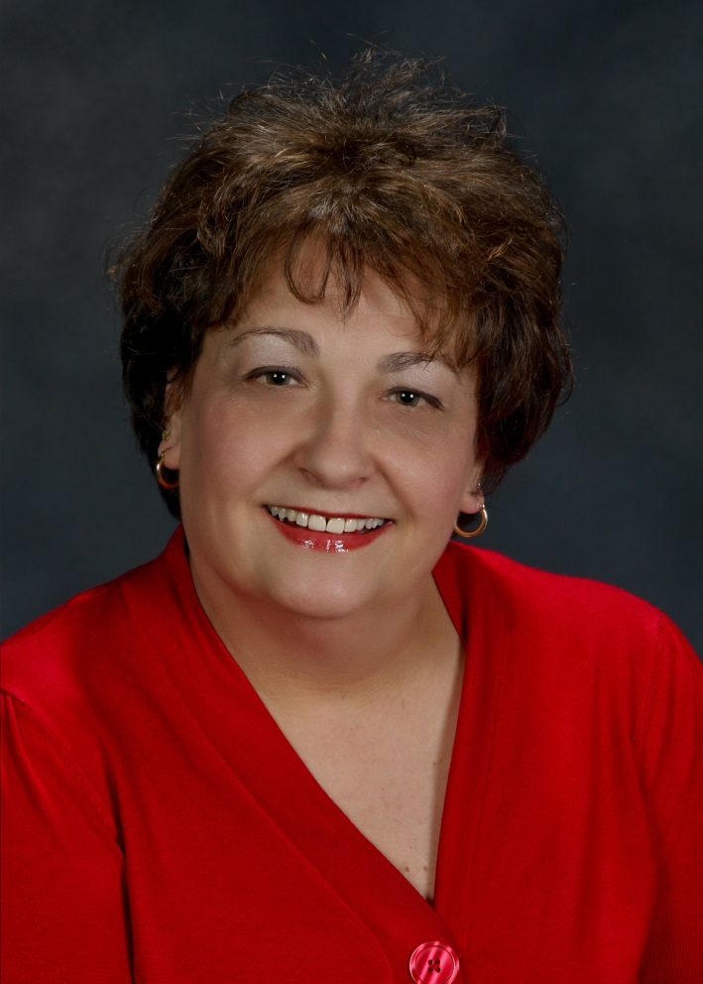
Welcome
Susan Ballard
AASL Past President
Program Director
Granite State College/University System of New Hampshire
Notes:
Susan- If you are here today you must already know the role school librarians play in ensuring our students are career and college ready and able to succeed in today’s educational landscape. This workshop is designed to make certain that every state has the necessary information and tools to ensure your state’s implementation of ESSA includes the critical component of school librarians in effective school library programs for teaching and learning.
The signing of Every Student Succeeds Act (ESSA) was a huge win for school libraries and the library community. Today we will start with an overview at the federal level and then end by preparing each and every one of you with messaging and strategy to ensure that when state, district or building level administrators think of ESSA they can connect to the school library.
First, we will watch a pre-recorded presentation by ALA’s Washington Office Executive Director, Emily Sheketoff who continuously works to ensure school librarians are included in federal legislation. ESSA is obviously an enormous win on this front but we should all be thankful for ALA’s Washington Office efforts and outcomes that do not stop with ESSA.
After Emily we will hear updates from the state level so that you are aware of state timelines and where work currently stands in the development of Massachusetts state ESSA plans. [insert names] will present those updates.
We will then walk through some key ESSA language and connect that language to the role you play as school librarians. It’s critical that these connections be made at every opportunity, even if the conversation doesn’t seem to be ESSA related because you are setting the groundwork for school librarians to be part of every conversation- consider when chatting with colleagues, parents, local business owners, etc.
After we walk through these three ‘layers’ of information it will then be time to roll up your sleeves and get to work. We will do some small group work and reporting out to brainstorm and identify stakeholders, connect messaging to their interests for a more compelling connection, and finally drafting and practicing elevator speeches. As you can see, while this workshop is focused on ESSA and state plans this is really about how you develop a strategic advocacy plan that can be used long after the ESSA plans are finalized and money allocated.

Slide 3
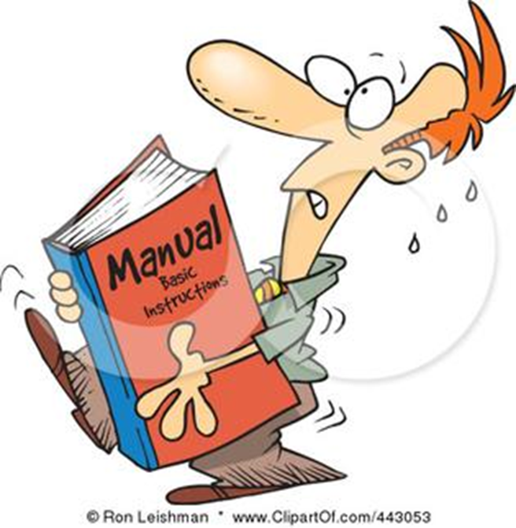
Handbook
Notes:
You should have all received a handbook for this workshop- everything you will see on the screen today (aside from the recording) is included with room to take notes. You also have some worksheets and then additional materials and resources. We know it’s a lot and probably looks a bit daunting, but we will cover it all and hopefully you will find it to be a resource to reference after the event.
Also, the presentation and materials will be given to MAME to post as they wish so please feel free to share this information with our colleagues.

Slide 4
SHARE, SHARE, SHARE
Tag @aasl
#ESSAlibraries
Send photos to jhabley@ala.org
Notes:
These are exciting times and ESSA is an opportunity that impacts every librarian in every state. AASL is making state specific presentations because there are nuances to each state’s implementation, and we also feel strongly in the power of face-to-face connections and group work, BUT, excitement and action is contagious! So we would love for all of you social media mavens in the group to share the work being done today with the school library community.

Slide 5
ESSA Webpage
http://essa.aasl.org/
Notes:
For all things AASL ESSA we’ve created a microsite. You should have a flyer that outlines what is included on the site but to highlight one important area is the “discussion forums.” While each state has approximately the same time table to get their plans done the role of the school librarian and involvement in those plans will vary and so let’s share- discuss your wins, discuss your struggles, just discuss. Also as we work through the material in the handbook you’ll be working on identifying stakeholders and developing messages and we would love for you to share those pieces too!

Slide 6
ALA Washington Office
Emily Sheketoff
Executive Director of Washington Office of American Library Association
Notes:
And now I’d like to introduce our executive director of the ALA Washington Office, Emily Sheketoff. Emily and her team were integral to not only our recent efforts and victory but also for her decade of continuous efforts to ensure the specific language for “school librarian” is included in K-12 legislation. Having legislators recognize school librarians and school library programs as critical to successful K-12 programs is a tremendous feat and we thank you and your team.
Emily was kind enough to record this presentation for these state workshops. Connect to Vimeo- https://vimeo.com/181232533

Slide 7
Massachusetts ESSA Update
Massachusetts Department of Education ESSA Page – http://www.doe.mass.edu/boe/docs/FY2016/2016-06/item16.html
Notes:
Here is the main page for ESSA information from the Massachusetts Department of Education.

Slide 8
Massachusetts ESSA Updates
Stakeholder Outreach Plan
http://www.doe.mass.edu/boe/docs/FY2016/2016-06/item16-OutreachPlan.pdf
MA DOE Presentation
http://www.doe.mass.edu/boe/docs/fy2016/2016-03/item3-ESSA.pdf
Notes:
Both of these documents have been included in your handbook, but here are the links

Slide 9
Massachusetts ESSA Updates
Three phases:
• Listening (April to June 2016): Asking broad questions of our stakeholder community about their thoughts on the purpose and design of the state’s accountability and assistance system
• Modeling (June to September 2016): Developing specific proposals based on the feedback we heard in the listening phase
• Proposing (September to December 2016): Sharing our draft proposals with stakeholders to further refine and improve them
Modifications to the system will be implemented at the beginning of the 2017–18 school year.
Notes:
Introduce MSLA representative to share.
As you can see this process will take time and while the proposing is underway the role of school librarians in this plan can not stop until the plan has been accepted, and includes school librarians/libraries. This timeline breaks down the phases but know that changes and adjustments will be taking place throughout the year so we must be vigilant in continuing our efforts to be seated at the table during these critical discussions.

Slide 10
How funding will impact MA
Initial estimates for SY2017-18 (first year of
ESSA implementation) compared to SY2015-16 indicate:
40%increase in Title IV 21st Century Schools
9 % increase in Title III English Learners
5 % decrease in Title II Effective Instruction
Consolidation of certain Title I subgrants
Flat funding across all ESSA programs combined
Notes:
This information is included in your handbook but just to give you a sense of how ESSA funding is expected to impact school funding the states-
40%increase in Title IV 21st Century Schools
9 % increase in Title III English Learners
5 % decrease in Title II Effective Instruction
Consolidation of certain Title I subgrants
Flat funding across all ESSA programs combined
The page after this listing gives specific dollar amounts to these areas

Slide 11
Connecting the Dots
Notes:
Susan- As Emily discussed, we are working within legislation that has specific language and requirements, and states that will be developing their own plans, so we are left to connect the dots for decision makers between the language they are speaking and the roles school librarians play in K-12 education and resources we are to their plan.
I know that these were covered by Emily, but we now want to get very specific on connect messages regarding the role of the school librarian to specific sections and language in ESSA.
You should have all received the “Ask Me How School Librarians Ensure Student Success” cards. AASL and ALA have distilled ESSA into the most basic format on these cards, but they are good starting point to think about your role in the school library and making those connections to your administrator and state level decision makers between ESSA funding and school libraries.
Please feel free to take additional cards.

Slide 12
Title I
Title I – Improving basic programs operated by state and local educational agencies
Message: School librarians and access to effective school library programs, impact student achievement, digital literacy skills, and school climate/culture.
Notes:
New provisions, but not requirements, include developing effective school library programs to provide students an opportunity to develop digital literacy skills and improve academic achievement.
First, how are you going to make sure that your school district realizes the school library program is the key to achieving digital literacy? What digital literacy programming/lessons are you already doing and can demonstrate?
Second, how are you impacting student achievement? School librarians are in a unique position because you directly impact student achievement by fostering critical thinking, providing students with the skills they need to analyze, form and communicate ideas in a compelling way. Additionally, you work with every student in the school and partner with teachers to provide print and digital materials to meet the diverse needs of your students and collaborating with teachers to deepen student learning in the classrooms.

Slide 13
Title II, Part A
Title II: Supporting effective instruction
Message: School librarians share their learning with other professionals when they attend conferences and workshops, applying the benefits of new techniques, strategies, and technologies to the entire district.
Notes:
Because States and school districts can now use their Title II, Part A funds specifically to support effective school library programming, it will be important to make sure that school district and school personnel that develop and implement professional development activities are aware of the new uses of funds related to libraries.
Note that under the No Child Left Behind Act (NCLB), Title II, Part A funds were primarily used for professional development for “teachers” which made it difficult for other instructional support personnel to participate in activities. ESSA rectifies this by specifically authorizing funds to be used to support instructional services provided by effective school library programs.
How have you been able to provide learning opportunities to educators in your school or district? School librarians are in a unique position to be leaders in their school by connecting classroom teachers, or district leaders, to current trends and resources for teaching and learning.

Slide 14
Title II, Part B
Title II, Part B: Literacy education for all, results for the nation (LEARN)/ Innovative Approaches to Literacy (IAL)
Message: School librarians are uniquely suited to lead the effort in applying for competitive grants because of their expertise and access to strong professional learning networks.
Notes:
LEARN and IAL are literacy grants and you must make the message clear that including school librarians, who are responsible for literacy instruction and development, in the application process is critical.
First, make sure that your state, school district, and/or school are aware of these grant opportunities.
Second, review the grant to see where you could provide expertise. Examples- IAL grant proposed projects may include:
Increase access to a wide range of literacy resources (either print or electronic) that prepare young children to read, and provide learning opportunities to all participating students;
Offer appropriate educational interventions for all readers with support from school libraries or national not-for-profit organizations;
There are other connects to be made, but approaching your state, district or school with information regarding these grants and then offering to assist with the application put you in a position to be seen as an indispensable resource and leader.

Slide 15
Title IV, Part A
Title IV, Part A: Student Support and Academic Enrichment Grants (Block Grants)
Message: School librarians increase access to personalized, rigorous learning experiences supported by technology, allowing equitable resources for all students.
Notes:
ESSA authorizes (but does not require) States to use funds to assist school districts in providing programs and activities that increase access to personalized, rigorous learning experiences supported by technology, including adequate “access to school libraries.”
ESSA also authorizes (but does not require) States to use funds to assist school districts in providing school librarians and other school personnel with the knowledge and skills to use technology effectively, including effective integration of technology, to improve instruction and student achievement.
State Educational Agencies (SEAs) may not be aware that these funds can support personalized learning experiences. Think of ways that your school library program has supported personalized learning experiences- it’s important to not just let your SEA know how the funds can be used but giving examples of work already in place connects those funds to the school library. Notice I’ve said a couple of times an ESSA provision that authorizes but does not require school libraries. Make this an opportunity to position the work of the school library. We’re providing tools for your community to run with this opportunity by advocating for effective school library programs.
And now let’s get to work!

Slide 16
Identifying Stakeholder

Slide 17
Coalitions
Critical to identify stakeholders
Including at the school, district (LEA) and state (SEA) levels
Form coalitions
Bring together groups and organizations that support libraries
Think outside the box
Utilize relationships and connections with education officials and policymakers in support of the effort
When anyone thinks of ESSA how do you get them to connect to school libraries
Be prepared to talk about positive impact of library programming in the community – How are you making a difference?
Notes:
This is an iteration of Emily’s presentation, but important.
Remember connections need to be made at all levels- school, district and state levels

Slide 18
ESSA Stakeholder Engagement Required Participants
Governor
State legislature
State boards of education
Local educational agencies
Representatives of Indian Tribes located in the state
Teachers
Principals & other school leaders
Specialized instructional support personnel
Paraprofessionals
Administration & other staff
Parents
Notes:
School librarians are in the specialized instructional support personnel along with music, art teachers etc. Get your seat at the table. And if not able to be at the table then be in the room through others who can advocate for school libraries and communicate ongoing issues and decisions. Who can you work with? Equitable access is an issue for state legislators who want their district to benefit as much as other districts. Pick a stakeholder. How will you approach them? How can you show school libraries serve their interests?

Slide 19
State Supports and Opportunities
Must provide support to schools not meeting state-determined goals for student and school performance
Must engage stakeholders and include them in the development of state plans to monitor student and school performance.
School Librarians are among the list of stakeholders
Be at the table!
Notes:
This is your moment to make sure a school librarian voice is heard when your state and local leaders are talking about the well rounded education they want students in your state to have. When a school fails to meet those goals, what should a plan to address that say about the school library program? How do you make a difference in literacy? School library programs go beyond the access to digital resources. How do you ensure teachers have the most relevant and pertinent materials? How do you instruct and engage students to be critical thinkers who succeed?
Step forward to participate. Or, if you are not at the table, who is, and how can they communicate your message and keep you informed as this planning process moves through your state?

Slide 20
Parent as Stakeholder Partners
ESSA includes a provision for family engagement. Parents must be “meaningfully consulted” and involved in:
State and local Title I plans
Title II state and local applications
Title III state and local plans
Title IV-A local applications
Title IV-B state applications
State and local report cards
School improvement plans
Notes:
Parents have long been among the strongest advocates for school libraries (think Spokane Moms). Many of you are parents actively involved in a local PTA. What is your state PTA doing? Ask them to support your efforts for effective school library programs.

Slide 21
Coalition Development Plan
Name individual/organization/business
What previous activities/news tie them to your efforts
What stake do they have in school library funding
What can they contribute to your plan
What three things could you do today to strengthen a relationship with them
Notes:
You should have a “Coalition Development Plan” in your handbook. You’ll see in the top row questions to ask yourself- think of a stakeholder, how they tie to your efforts, what stake do they have in seeing school library programs funded, how can they contribute to your efforts, and what three things can you think of right now that you could do to strengthen your relationship with them.

Slide 22
Coalition Development Plan
Notes:
We’ve already covered parents, but as Emily mentioned, this is your chance to think outside the box, look at your community and it’s needs.
Take 15 minutes and either pair up, or get into small groups and brainstorm ideas to fill out your sheet. We will then come back together and share our lists

Slide 23
Coalition Development Plan
Notes:
Who would like to share some of the stakeholders they have identified….

Slide 24
Connect Message to Stakeholder
Notes:
You have the message cards, you have your coalition development plan, now it’s time to figure out how to translate your critical role into a language that will appeal to your potential coalition members.

Slide 25
Key Words/Phrases
Specialized instructional support staff
Digital literacy skills
Academic achievement
Personalized, rigorous learning experiences
Adequate access to school libraries
Use technology effectively
Effective integration of technology
Improve instruction and student achievement
Notes:
These key words/phrases are also highlighted in the handbook document. Again, to go back to Emily’s presentation, these are the phrases that will be used in the ESSA plans and so connecting what school librarians do through this language is important.

Slide 26
Example
Individual/Organization/ Business Name | What previous activities, news or accomplishments tie them to your efforts? | What stake do they have in school library funding? | What can they contribute to your plan? | What three things could you do today to strengthen a relationship with them?
Local public library | Summer reading programs, marketing regarding access to information and technology for community | School libraries create knowledgeable library users; school libraries fill a specific role in connection to curriculum and without would create a gap between services | General public awareness; engaging non-parents, but library friends in efforts | 1. Meet with staff to provide information. 2. Ask to hold an information session at public library for general public 3. Ask to present to their friends group and in return offer time with school parents group
Key Message Development:
School librarians are teachers, specialized instructional support staff, trained to teach library skills early and develop lifelong library users and supporters.
The public library is an incredible asset to students as they continue their work outside of school but a fully staff and funded school library connects student personalized, rigorous learning experience, and library research, to academic achievement.
Digital literacy skills are essential for success as students move into the work force that requires the effective use of technology and while there is a direct impact for parents to support a strong school library program there is tremendous value for the business and community too.
Notes:
This example is included in your handbook, so no need to squint. What you will do now, and can work with a partner or small group, is to take each line from your coalition development plan, remembering the key words/phrases, and message cards, to create message sentences that would appeal to that stakeholder. One message per column.
One sentence will connect what you have listed as what your stakeholder has accomplished that has tied them to your efforts.
One sentence will connect what stake you have listed that they have in school library funding.
One sentence will connect what they can contribute to your plan.
For this example, we have the local public library who offers summer reading programs and market to the public the need for access to information.
This ties to a school librarians role in developing lifelong library supporters, or as the message would read:
- School librarians are teachers, specialized instructional support staff, trained to teach library skills early and develop lifelong library users and supporters.
You may not be able to get through all of your stakeholders, and you may want to pair up or work in small groups to brainstorm, but let’s take the next 20 minutes to come up with messages. If you work in pairs or groups see which stakeholder groups you have in common and start from there.

Slide 27
Connecting the Dots- Key Messages
Notes:
Who would like to share some of the messages they have developed

Slide 28
ESSA Elevator Speech
Notes:
While ESSA has afforded school librarians a tremendous opportunity, we hope that it’s clear that these exercises and the discussions and idea you are coming up with are advocacy for school librarians in general. That’s why even if you school is not eligible for everything in ESSA making the connection between education priorities and role of the school librarian is critical anytime.
The elevator speech. We’ve all heard of it: what you would say to someone if you had an opportunity to sell the library in a limited time exchange -- the ride from the hotel lobby to your floor. Or the taxi chat, or the grocery store, or parking lot speech.
Hard part – it forces you to be on. All the time. And ready to answer a multitude of questions -- “are there really that many libraries left? What with e-books and the internet are they necessary? Are the layoffs at your school affecting your job?” Where do you go with so many of these questions?
So for today, let’s just focus on ESSA. How to make the case for ESSA, but again, these message can easily translate into the important role school librarians play in education.

Slide 29
Connecting the dots
Four ESSA areas (Title I, Title II- Part A, Title II- Part B, and Title IV, Part A)
Review the key messages on your message card
Connect the dots to your work
Notes:
By now you should have a lot of “work’” in front of you that we are going to pull together into one last final step.
Here are the steps we will take to craft our elevator ride:
Review the four ESSA areas
Review the key messages on your card
Connect the dots to your work in a way that can relate to anyone

Slide 30
Example
Title I: Improving basic programs operated by state and local educational agencies
Message: School librarians and access to effective school library programs, impact student achievement, digital literacy skills, and school climate/culture.
Conversation Response: Yes, the internet has certainly put information at your fingertips but do you believe everything you read on the internet? Students today have a hard time navigating such a vast amount of information and learning digital literacy skills is critical to their success in school and after when they navigate college or start a career.
Notes:
You should have a handout entitled “Elevator Speech” – we will take 5 minutes for everyone to work independently and come up with response answers for the conversation starter “are there really that many libraries left? What with e-books and the internet are they necessary?” Draft responses that can connect back to each of the message points and four ESSA sections.
Here is an example-
Look at the ESSA language
Look at the message you developed
Taking those two components incorporate into an answer to the questions “are there really that many libraries left? What with e-books and the internet are they necessary”?

Slide 31
ESSA Elevator Speech
Reminders:
The intention is to educate not humiliate.
What you do is important, so sound important.
Practice
You can start the conversation.
Notes:
Reminders:
The intention is to educate not humiliate. You want to get the key words that ESSA uses into your responses but treat this cab drive as you would a patron who asks a question that may seem obvious to you. Also, stay away from library lingo- “a library program” sounds like a read aloud not everything that encompasses your library activities, strategic plan and mission. Often library lingo actually works against the message being received.
Yes, access to information and equitable resources is very important, but look at the message card and translate into a simple, important message. “School librarians are often the single person in a school that can see the information needs of the entire student body and classroom teachers, and connect those needs to the necessary resources.”
It may sound silly the more you articulate your “chat” and fine-tune your key points the more impactful each new encounter will be.
Don’t wait for the opportunity, think of conversation starters that will lead you down the path to your topic.

Slide 32
Elevator Speech Development
Step One: Make the connection from ESSA language to AASL’s school library talking points to your school library program.
Step Two: Practice
Step Three: Fine Tuning
Step Four: Practice Again
Notes:
These steps are all outlined in the handout in your handbooks but let’s run through quickly.
Step 1- we’ve pre-filled the ESSA Language and messages from the message cards in the first two columns.
The third column is where you take the ESSA language and school library talking point to “answer” the questions at the top:
“Are there really any libraries left? “
“What with e-books and Internet are they necessary?”
The final column is where you connect your answer to actual events, practice, experiences you’ve had in your school library.
You now need to fill in the chart- once that is done hold on before going to the next step. Since the chart requires you to add personal experiences this can be done independently but don’t hesitate to share example or ideas if you or a neighbor appear stuck. We will check back in in about 15 minutes to see where everyone is.

Slide 33
Elevator Speech Development
Step One: Make the connection from ESSA language to AASL’s school library talking points to your school library program.
Step Two: Practice
Step Three: Fine Tuning
Step Four: Practice Again
Notes:
Step 2
• Pair up with someone, or form a small group (3-4)
• One person asks: Are there really any libraries left? What with e-books and Internet are they necessary?
• The other person practices their answer to the question, and provides an example from their experience.
• Switch roles, and continue until you’ve each had a chance to run through all four ESSA sections.
Take 15 minutes to practice

Slide 34
Elevator Speech Development
Step One: Make the connection from ESSA language to AASL’s school library talking points to your school library program.
Step Two: Practice
Step Three: Fine Tuning
Step Four: Practice Again
Notes:
Step Three: Fine Tuning
Take a few minutes to discuss each other’s talking points. Was the message clear? Could you picture the experience they were providing as an example? If you were someone with no connection to school libraries would the message compel you to re-think the role of the school library in today’s world?
It’s very easy to “preach to the choir” so critically consider the wording that’s being used. For instance, someone may be not understand a circulation statistic- but someone would understand the need for a fully funded program so that students can access books for pleasure reading at any time, and connect the technology role of the school librarian- it’s not just about have books on shelves, which is important, but you also curate e-books. This is a message that make a connection instead of discussing the high volume of circulation in your library.
Take 15 minutes

Slide 35
Elevator Speech Development
Step One: Make the connection from ESSA language to AASL’s school library talking points to your school library program.
Step Two: Practice
Step Three: Fine Tuning
Step Four: Practice Again
Notes:
Step Four- Practice Again
Think about those times in your life when you’ve had to speak about something important- a presentation, a serious conversation with your supervisor, perhaps a difficult conversation with a parent- you didn’t jot down a few notes and then forget about it until that time came to talk. At the very least you ran through the conversation in your head several times.
You could find yourself in a situation in which you have one chance to make a last impression on a key decision maker- be prepared. On your ride to/from work practice the conversation. Take one message point per day and practice in the mirror. Each message will take less than a minute to practice and that is time well spent when your strong message ensures the valuable place school librarians and school libraries will continue to play in today’s education.

Slide 36
Questions
Notes:
We have a few minutes left for questions.

